Slide 1
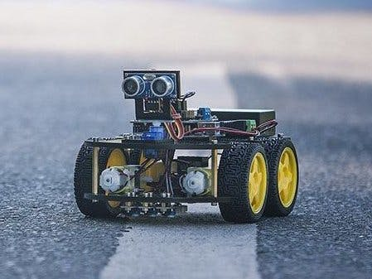
System Engineering & Prototyping
Group : 4
Group Members:
Abu Sayem
Subir Balo
Ismail Hossain
Hammad Karamat
[1]

Slide 2
Diagrams
[2]

Slide 3
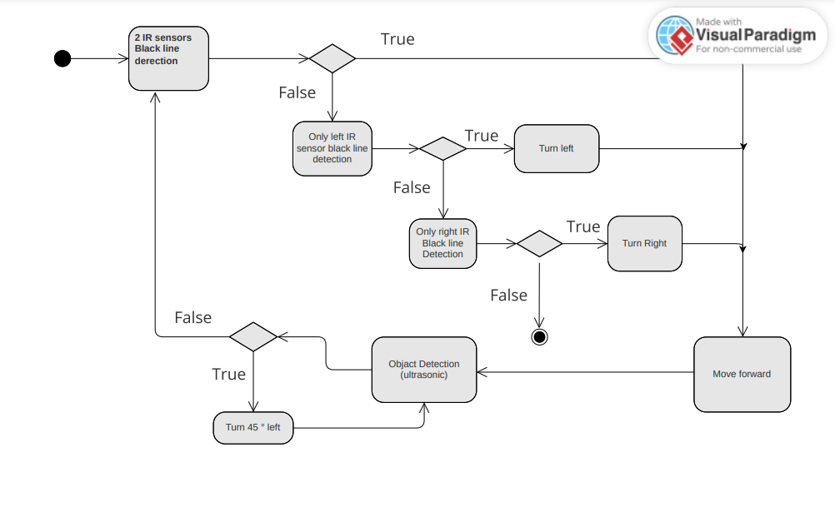
Activity Diagram

Slide 4
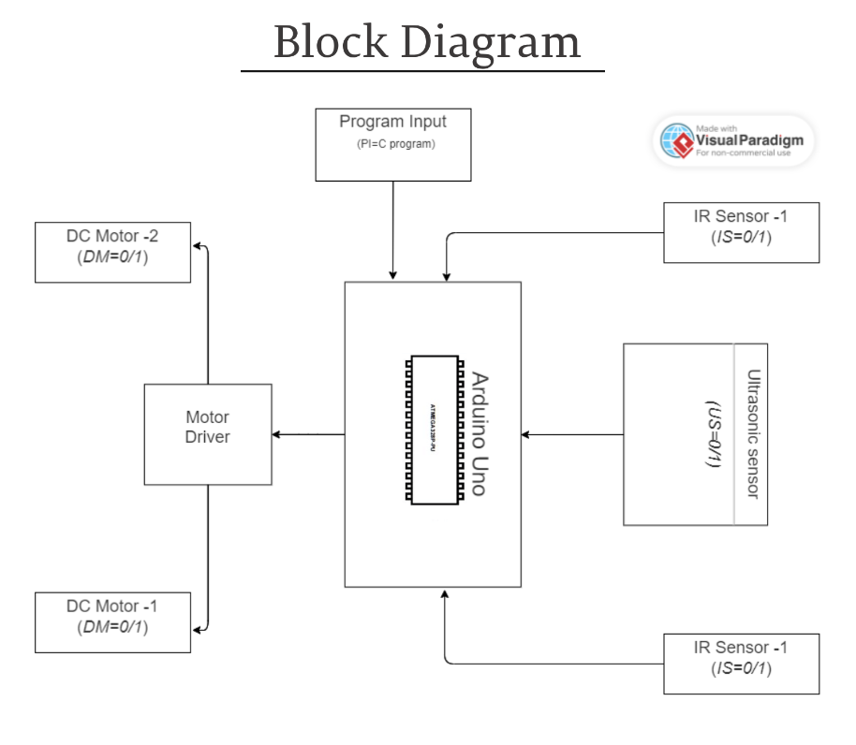
Block Diagram

Slide 5
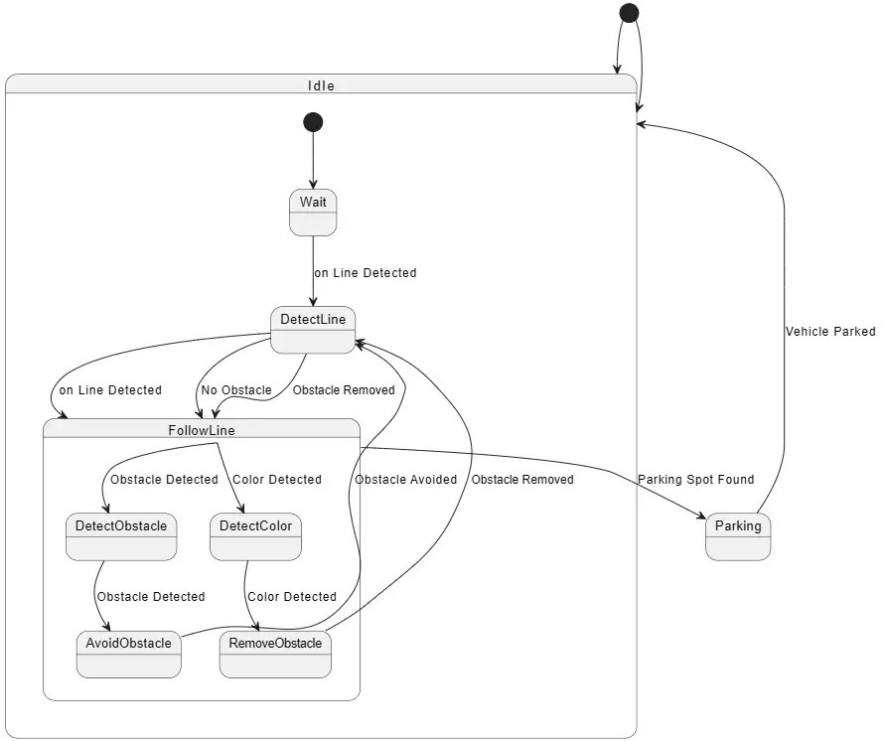
Statemachine

Slide 6
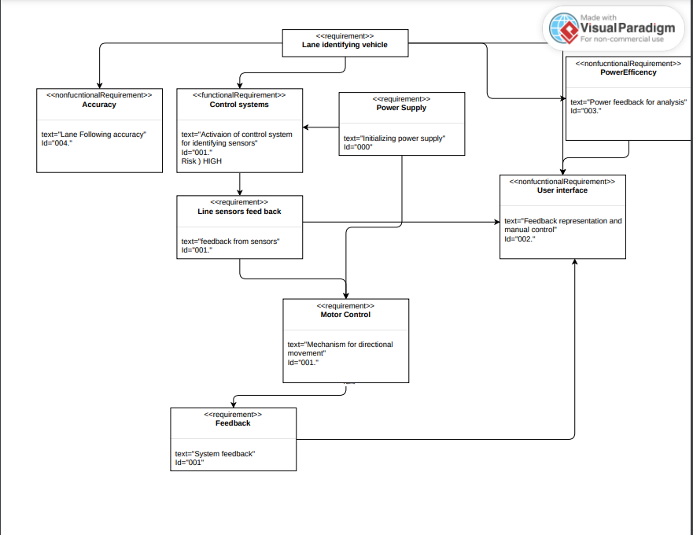
Requirement Diagram

Slide 7
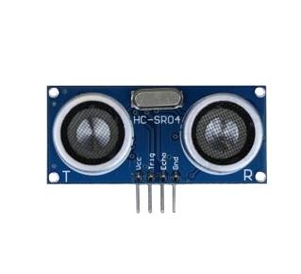
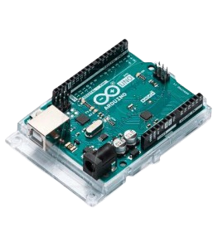
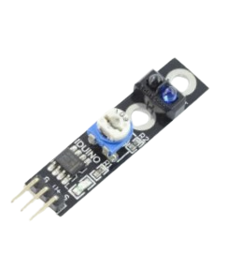
Hardware Components
Microcontroller Arduino Wifi Rev 2
Ultrasonic Sensor (HC-SRO4)
Line Sensor ( IR Sensor, ST1140)

Slide 8
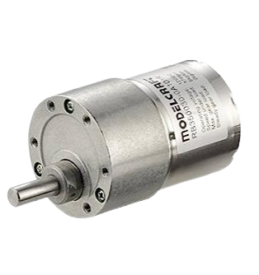
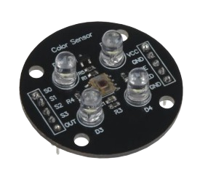
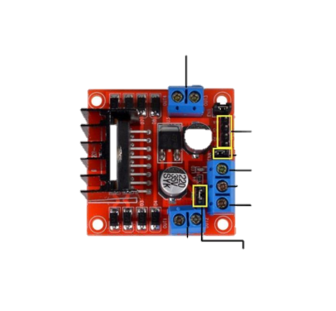
Colour Sensor(TCS3200)
2 DC Motors
Motor Driver

Slide 9

Design
[3]

Slide 10

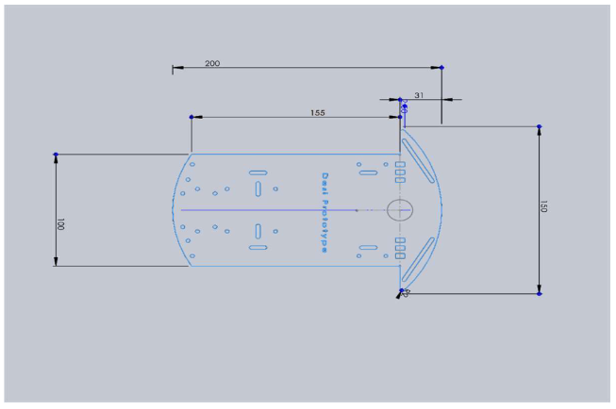


Dimensions

Slide 11
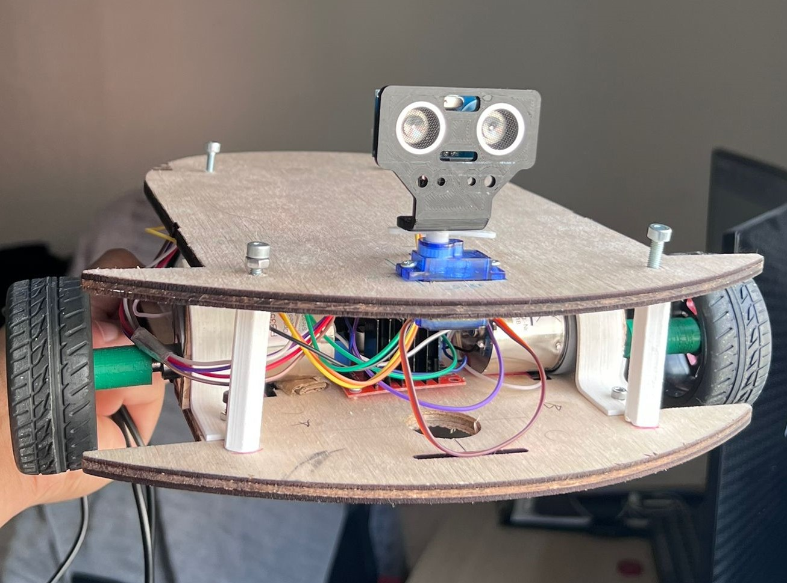
Front View

Slide 12
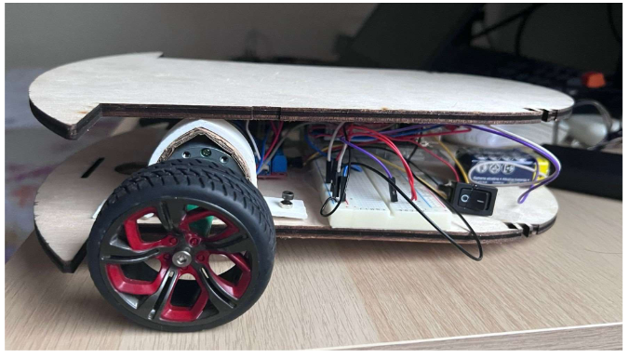
Side View

Slide 13
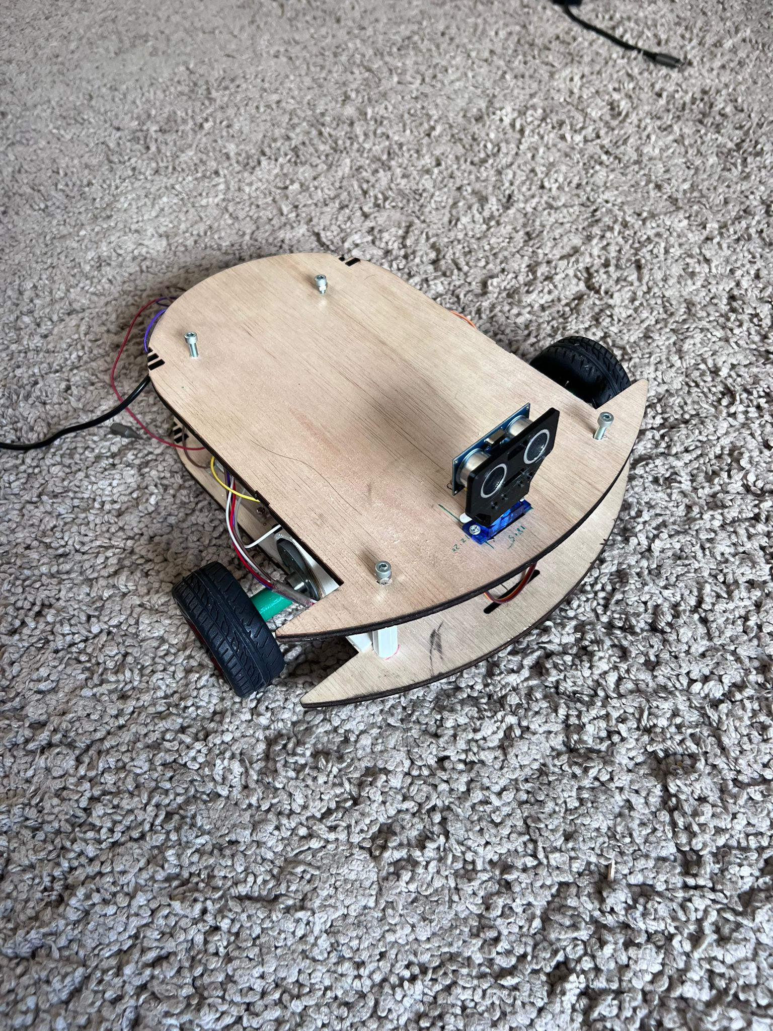
Top View

Slide 14

Programming
[4]

Slide 15
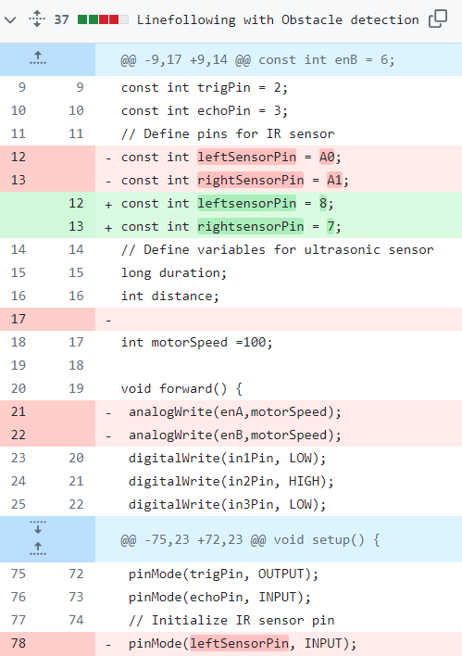

Slide 16
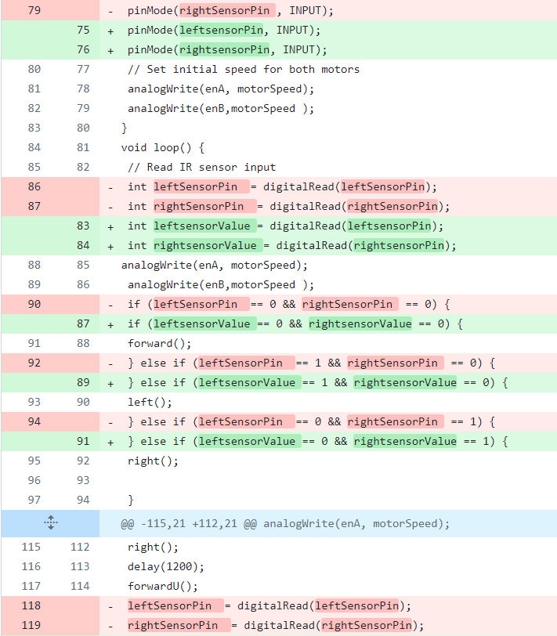

Slide 17
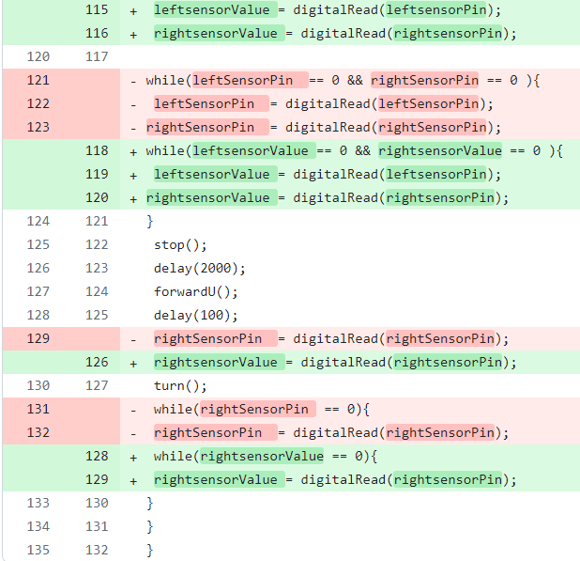

Slide 18
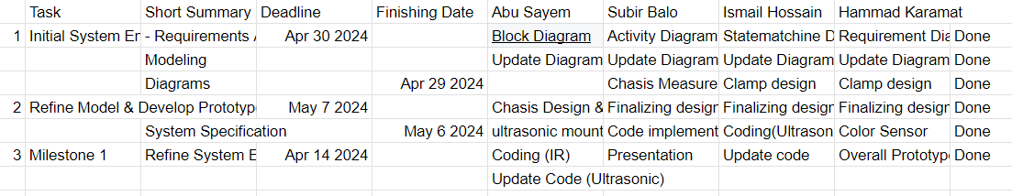
Task Overall

Slide 19
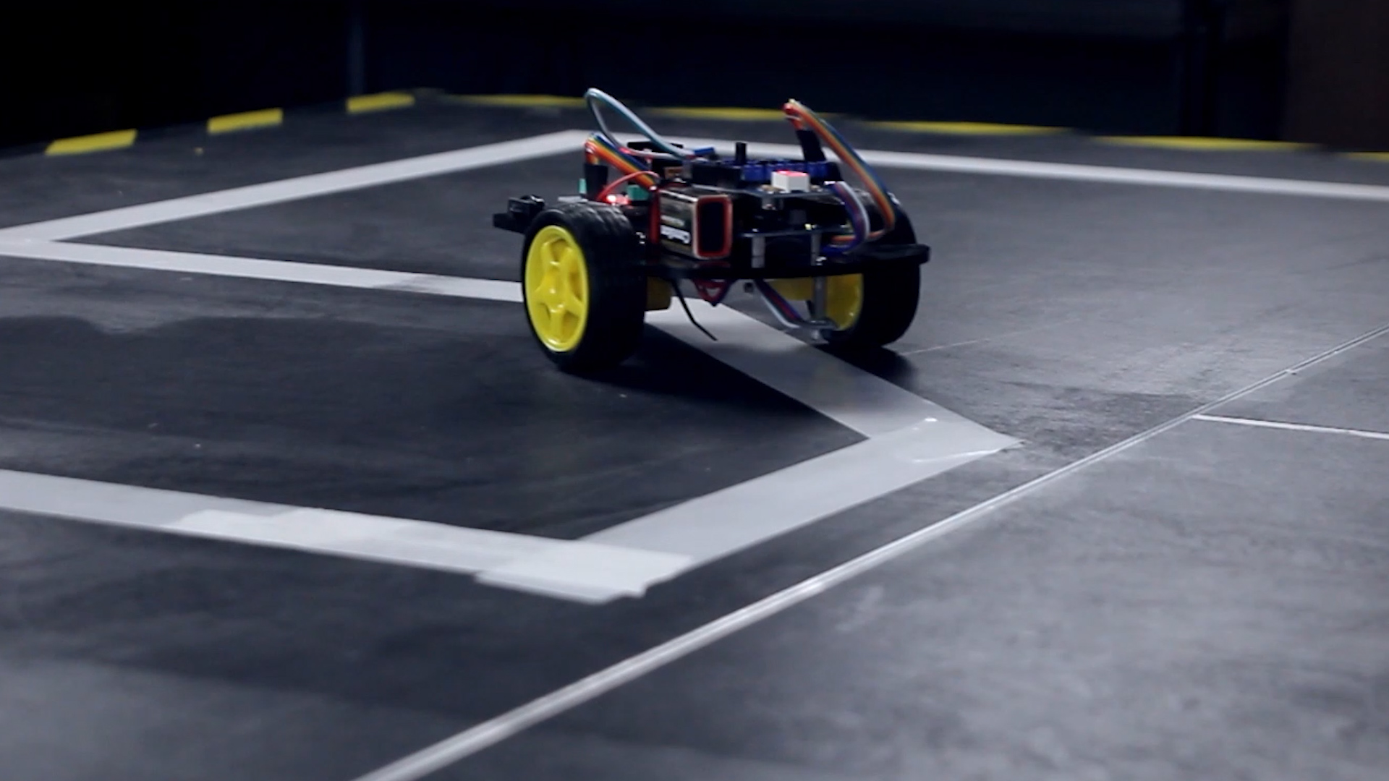
Thank You
5

Slide 20
Reference
[1] Hackster.io. (2020, January 3). Line Follower Robot -Very fast using port manipulation. https://www.hackster.io/Laheeb/line-follower-robot-very-fast-using-port-manipulation-c87639
[2] Hackster.io. (2020, January 3). Line Follower Robot -Very fast using port manipulation. https://www.hackster.io/Laheeb/line-follower-robot-very-fast-using-port-manipulation-c87639 Logical vs. Physical Data Flow Diagram. (n.d.). Lucidchart. https://www.lucidchart.com/pages/data-flow-diagram/logical-vs-physical-data-flow-diagram
[3] Graphic design - Voyou - Creative Performance. (n.d.). https://www.voyou.com/voyou-services/graphic-design.html Hackster.io. (2020, January 3). Line Follower Robot -Very fast using port manipulation. https://www.hackster.io/Laheeb/line-follower-robot-very-fast-using-port-manipulation-c87639 Logical vs. Physical Data Flow Diagram. (n.d.). Lucidchart. https://www.lucidchart.com/pages/data-flow-diagram/logical-vs-physical-data-flow-diagram
[4] Graphic design - Voyou - Creative Performance. (n.d.). https://www.voyou.com/voyou-services/graphic-design.html Hackster.io. (2020, January 3). Line Follower Robot -Very fast using port manipulation. https://www.hackster.io/Laheeb/line-follower-robot-very-fast-using-port-manipulation-c87639 Logical vs. Physical Data Flow Diagram. (n.d.). Lucidchart. https://www.lucidchart.com/pages/data-flow-diagram/logical-vs-physical-data-flow-diagram UXWing. (2020, May 27). Programmer icon PNG and SVG Vector Free Download. UXWing. https://uxwing.com/programmer-icon/ Wikipedia-Autoren. (2018). DateI:HSHL-Logo.svg – Wikipedia. https://de.wikipedia.org/wiki/Datei:HSHL-Logo.svg
[5] Esan. (2021, April 2). Whadda - DIY Line Follower Tutorial with Arduino STEM shield. Whadda. https://whadda.com/make-a-one-sensor-line-follower-with-the-arduino-stem-shield/ Graphic design - Voyou - Creative Performance. (n.d.). https://www.voyou.com/voyou-services/graphic-design.html Hackster.io. (2020, January 3). Line Follower Robot -Very fast using port manipulation. https://www.hackster.io/Laheeb/line-follower-robot-very-fast-using-port-manipulation-c87639 line following car - Google Search. (n.d.). https://www.google.com/search?sca_esv=5cd974b4dba8bebc&sca_upv=1&rlz=1C1FKPE_deDE1098DE1106&sxsrf=ADLYWIIIfW8ZkCHkQiY-qQllO2Ip0BcHKA:1719235810384&q=line+following+car&udm=2&fbs=AEQNm0Aa4sjWe7Rqy32pFwRj0UkWd8nbOJfsBGGB5IQQO6L3J_86uWOeqwdnV0yaSF-x2jornR9l9QoC_W7eufnFEmyEHeDjy4O0OWyYQ0fz3JjBQfGYnxplk1tJrXWXGVUQmsq8GmAE9Q1XW7FW1vkgCJssYdAy0IKQq2tR8PJjONL933B-eBuE-V0FnNrJe0NHfwCxxYP0&sa=X&ved=2ahUKEwiwgo2-rPSGAxX69gIHHeH1D6oQtKgLegQIFRAB&biw=1536&bih=738&dpr=1.25#vhid=RubVWGbZqrpe3M&vssid=mosaic Logical vs. Physical Data Flow Diagram. (n.d.). Lucidchart. https://www.lucidchart.com/pages/data-flow-diagram/logical-vs-physical-data-flow-diagram UXWing. (2020, May 27). Programmer icon PNG and SVG Vector Free Download. UXWing. https://uxwing.com/programmer-icon/ Wikipedia-Autoren. (2018). DateI:HSHL-Logo.svg – Wikipedia. https://de.wikipedia.org/wiki/Datei:HSHL-Logo.svg
Graphic design - Voyou - Creative Performance. (n.d.). https://www.voyou.com/voyou-services/graphic-design.html Hackster.io. (2020, January 3). Line Follower Robot -Very fast using port manipulation. https://www.hackster.io/Laheeb/line-follower-robot-very-fast-using-port-manipulation-c87639 Logical vs. Physical Data Flow Diagram. (n.d.). Lucidchart. https://www.lucidchart.com/pages/data-flow-diagram/logical-vs-physical-data-flow-diagram Wikipedia-Autoren. (2018). DateI:HSHL-Logo.svg – Wikipedia. https://de.wikipedia.org/wiki/Datei:HSHL-Logo.svg (HOCHSCHULE HAMM-LIPPSTADT LOGO)

